Slide 1
Ch- 8. Class Diagrams
Class diagrams are the most common diagram found in modeling object- oriented systems.
Class diagrams are important not only for visualizing, specifying, and documenting structural models, but also for constructing executable systems through forward and reverse engineering.

Slide 2
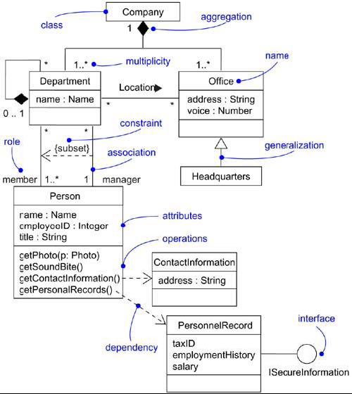
Class Diagram

Slide 3
A class diagram is a diagram that shows a set of classes, interfaces, and collaborations and their relationships.
Graphically, a class diagram is a collection of vertices and arcs.

Slide 4
Class diagrams commonly contain the following things:
Classes
Interfaces
Collaborations
Dependency, generalization, and association
relationships.
Like all other diagrams, class diagrams may contain notes and constraints.

Slide 5
Class diagrams may also contain packages or subsystems, both of which are used to group elements of your model into larger chunks.
Class diagrams are used to model the static design view of a system. This view primarily supports the functional requirements of a system- the services the system should provide to its end users.

Slide 6
Common Uses
When you model the static design view of a system, you'll typically use class diagrams in one of three ways.
To model the vocabulary of a system
Modeling the vocabulary of a system involves making a decision about which abstractions are a part of the system under consideration and which fall outside its boundaries. You use class diagrams to specify these abstractions and their responsibilities.

Slide 7
2. To model simple collaborations
A collaboration is a society of classes, interfaces, and other elements that work together to provide some cooperative behavior that's bigger than the sum of all the elements.
For example, when you're modeling the semantics of a transaction in a distributed system, you can't just stare at a single class to understand what's going on. Rather, these semantics are carried out by a set of classes that work together.

Slide 8
3. To model a logical database schema
Think of a schema as the blueprint for the conceptual design of a database. In many domains, you'll want to store persistent information in a relational database or in an object-oriented database.

Slide 9
Common Modeling Techniques
Modeling Simple Collaborations
Modeling a Logical Database Schema
Forward and Reverse Engineering

Slide 10
Modeling Simple Collaborations
Identify the mechanism you'd like to model. A mechanism represents some function or behavior of the part of the system you are modeling that results from the interaction of a society of classes, interfaces, and other things.
For each mechanism, identify the classes, interfaces, and other collaborations that participate in this collaboration. Identify the relationships among these things, as well.

Slide 11
Use scenarios to walk through these things. Along the way, you'll discover parts of your model that were missing and parts that were just plain semantically wrong.
Be sure to populate these elements with their contents. For classes, start with getting a good balance of responsibilities. Then, over time, turn these into concrete attributes and operations.

Slide 12
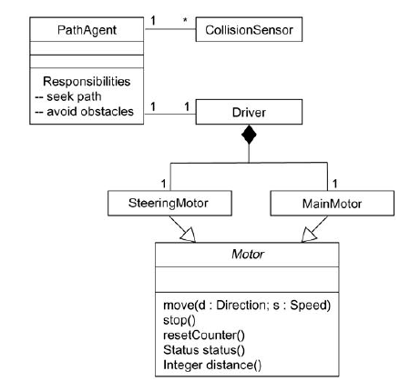

Slide 13
Modeling a Logical Database Schema
Identify those classes in your model whose state must transcend the lifetime of their applications.
Create a class diagram that contains these classes and mark them as persistent (a standard tagged value). You can define your own set of tagged values to address database-specific details.
· Expand the structural details of these classes. In general, this means specifying the details of their attributes and focusing on the associations and their cardinalities that structure these classes.
.

Slide 14
· Watch for common patterns that complicate physical database design, such as cyclic associations, one-to-one associations, and n-ary associations. Where necessary, create intermediate abstractions to simplify your logical structure.
· Consider also the behavior of these classes by expanding operations that are important for data access and data integrity. In general, to provide a better separation of concerns, business rules concerned with the manipulation of sets of these objects should be encapsulated in a layer above these persistent classes.
· Where possible, use tools to help you transform your logical design into a physical Design

Slide 15
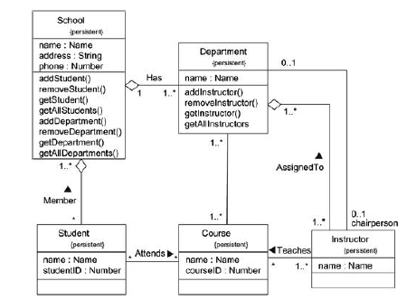

Slide 16
Forward and Reverse Engineering
Forward engineering is the process of transforming a model into code through a mapping to an implementation language. Forward engineering results in a loss of information, because models written in the UML are semantically richer than any current object-oriented programming language.

Slide 17
To forward engineer a class diagram,
Identify the rules for mapping to your implementation language or languages of choice.
Depending on the semantics of the languages you choose, you may want to constrain your use of certain UML features.
Use tagged values to guide implementation choices in your target language.
Use tools to generate code.

Slide 18
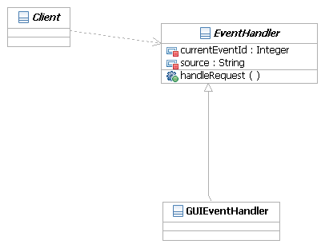
Forward And Reverse Engineering
JAVA Code
public abstract class EventHandler
{
private Integer currentEventId;
private String source;
public void handleRequest()
{
// begin-user-code
// TODO Auto-generated method stub
// end-user-code
}
}

Slide 19
Reverse engineering is the process of transforming code into a model through a mapping from a specific implementation language. Reverse engineering results in a flood of information, some of which is at a lower level of detail than you'll need to build useful models. At the same time, reverse engineering is incomplete.

Slide 20
To reverse engineer a class diagram,
Identify the rules for mapping from your implementation language or languages of choice.
Using a tool, point to the code you'd like to reverse engineer. Use your tool to generate a new model or modify an existing one that was previously forward engineered. It is unreasonable to expect to reverse engineer a single concise model from a large body of code. You need to select portion of the code and build the model from the bottom.

Slide 21
Using your tool, create a class diagram by querying the model. For example, you might start with one or more classes, then expand the diagram by following specific relationships or other neighboring classes. Expose or hide details of the contents of this class diagram as necessary to communicate your intent.
Manually add design information to the model to express the intent of the design that is missing or hidden in the code.

Slide 22
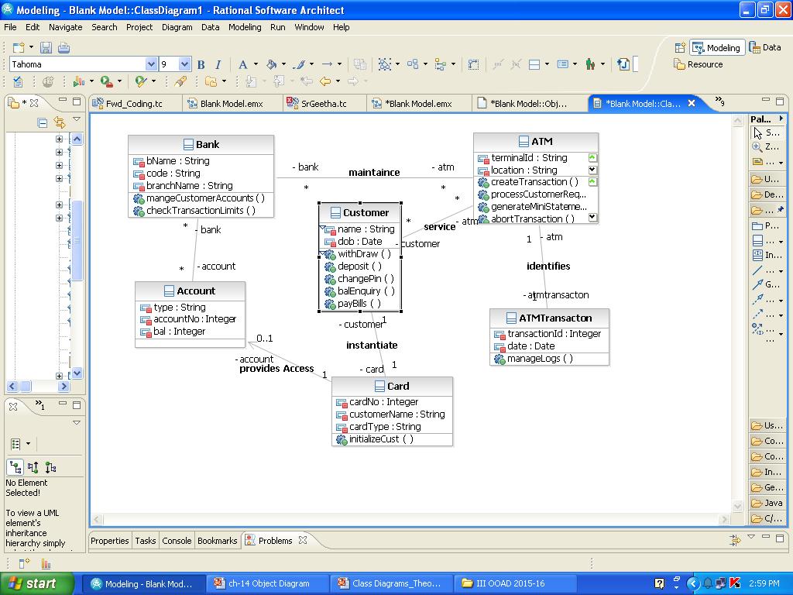
Class Diagram for ATM

Slide 23
Advanced Classes
CLASSIFIERS:-
A classifier is a mechanism (or an approach) that describes structural and behavioral features.
EX:classes, interfaces, data types, signals, components, nodes, use cases, and subsystems.
The most important kind of classifier in the UML is the class.

Slide 24
Description of Classifiers
Interface : A collection of operations that are used to specify a service of a class or a component.
2. Datatype: The classification of type of data an attribute can hold, including primitive built-in types (such as numbers and strings), as well as enumeration types (such as Boolean).

Slide 25
3. Signal: The specification of an asynchronous event.
4. Component: A physical and replaceable part of a system that conforms to and provides the realization of a set of interfaces.
5. Node: A physical element that exists at run time and that represents a computational resource, generally having at least some memory and often processing capability.

Slide 26
6. Use case: A description of a set of a sequence of actions that a system performs that yields an observable result of value to a particular actor.
7. Subsystem: A grouping of elements of which some constitute a specification of the behavior.

Slide 27
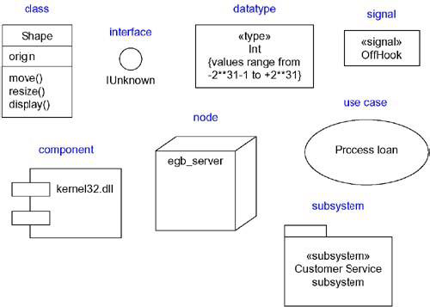
Graphically, the UML distinguishes among these different classifiers, as

Slide 28
Visibility:-
The most important details you can specify for a classifier's attributes and operations is its visibility.
The visibility of a feature specifies whether it can be used by other classifiers.
In the UML, you can specify any of three levels of visibility.

Slide 29
Public: Any outside classifier with visibility to the given classifier can use the feature; specified by prepending the symbol +
2. Protected: Any descendant of the classifier can use the feature; specified by prepending the symbol #
3. Private: Only the classifier itself can use the feature; specified by prepending the symbol -

Slide 30
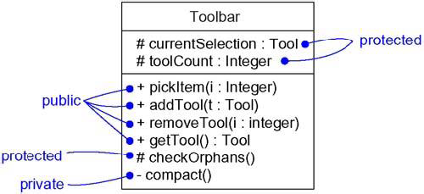
Visibility

Slide 31
Scope:-
Another important detail you can specify for a classifier's attributes and operations is its owner scope.
The owner scope of a feature specifies whether the feature appears in each instance of the classifier.

Slide 32
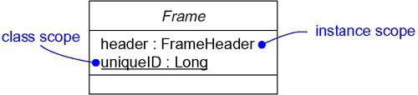
In the UML, you can specify two kinds of owner scope.
Instance: Each instance of the classifier holds its own value for the feature.
2. Classifier: There is just one value of the feature for all instances of the classifier.
Owner Scope

Slide 33
Abstract, Root, Leaf, and Polymorphic Elements
Use generalization relationships to model classes, with more-generalized abstractions at the top of the hierarchy and more-specific ones at the bottom.

Slide 34
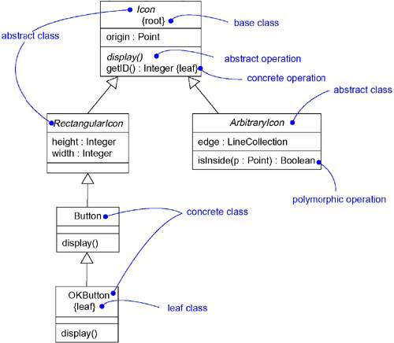
Abstract and Concrete Classes and Operations

Slide 35
A class may have no children. Such an element is called a leaf class and is specified in the UML by writing the property leaf below the class's name.
For example, in the figure, OKButton is a leaf class, so it may have no children.
Less common but still useful is the ability to specify that a class may have no parents. Such an element is called a root class, and is specified in the UML by writing the property root below the class's name.
For example, in the figure, Icon is a root class.

Slide 36
The operation Icon::display() is abstract, meaning that it is incomplete and requires a child to supply an implementation of the operation.

Slide 37
Multiplicity:-
The number of instances a class may have is called its multiplicity.
In the UML, you can specify the multiplicity of a class by writing a multiplicity expression in the upper-right corner of the class icon.

Slide 38
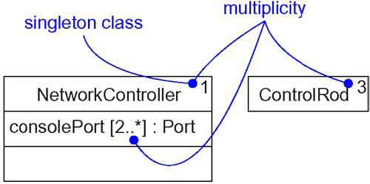
For example, in NetworkController is a singleton class. Similarly, there are exactly three instances of the class ControlRod in the system.

Slide 39
Multiplicity applies to attributes, as well. You can specify the multiplicity of an attribute by writing a suitable expression in brackets just after the attribute name.
For example, in the figure, there are two or more consolePort instances in the instance of NetworkController.

Slide 40
Attributes:-
At the most abstract level, when you model a class's structural features (that is, its attributes), you simply write each attribute's name.
The syntax of an attribute in the UML is
[visibility] name [multiplicity] [: type][= initial-value] [{property-string}]

Slide 41
For example, the following are all legal attribute declarations:
origin | Name only
+ origin | Visibility and name
origin : Point | Name and type
head : *Item | Name and complex type
name [0..1] : String | Name, multiplicity, and type
origin : Point = (0,0) | Name, type, and initial value
id : Integer {frozen} | Name and property

Slide 42
There are three defined properties that you can use with attributes.
changeable | There are no restrictions on modifying the attribute's value.
addOnly | For attributes with a multiplicity greater than one, additional values may be added, but once created, a value may not be removed or altered.
frozen | The attribute's value may not be changed after the object is initialized.
Unless otherwise specified, attributes are always changeable. You'll mainly want to use frozen when modeling constant or write-once attributes.

Slide 43
Operations:-
At the most abstract level, when you model a class's behavioral features (that is, its operations and its signals), you will simply write each operation's name.
You can also specify the parameters, return type, concurrency semantics, and other properties of each operation.
Collectively, the name of an operation plus its parameters (including its return type, if any) is called the operation's signature.

Slide 44
The UML distinguishes between operation and method.
An operation specifies a service that can be requested from any object of the class to affect behavior;
A method is an implementation of an operation.

Slide 45
The syntax of an operation in the UML is
[visibility] name [(parameter-list)][: return-type] [{property-string}]
For example, the following are all legal operation declarations:
display | Name only
+ display | Visibility and name
set(n : Name, s : String) | Name and parameters
getID() : Integer | Name and return type

Slide 46
Standard Elements:-
The UML defines four standard stereotypes that apply to classes.
1. metaclass- Specifies a classifier whose objects are all classes.
2. powertype- Specifies a classifier whose objects are the children of a parent.
3.stereotype -Specifies that the classifier is a stereotype that may be applied to other elements.
4. utility - Specifies a class whose attributes and operations are all class scoped.

Slide 47
Ch-10 Advanced Relationships
A relationship is a connection among things.
In object-oriented modeling, the four most important relationships are dependencies, generalizations, associations, and realizations.
Graphically, a relationship is rendered as a path, with different kinds of lines used to distinguish the different relationships.

Slide 48
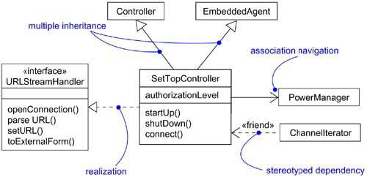
Advanced Relationships

Slide 49
Dependency
A dependency is a using relationship, specifying that a change in the specification of one thing (for example, class SetTopController) may affect another thing that uses it (for example, class ChannelIterator), but not necessarily the reverse.
Graphically, a dependency is rendered as a dashed line, directed to the thing that is depended on.

Slide 50
UML defines a number of stereotypes that may be applied to dependency relationships. There are 17 such stereotypes.
First, there are eight stereotypes that apply to dependency relationships among classes and objects in class diagrams.
1. bind: Specifies that the source instantiates the target template using the given actual parameters.
Bind includes a list of actual arguments that map to the formal arguments of the template.

Slide 51
2. derive: Specifies that the source may be computed from the target.
Use derive when you want to model the relationship between two attributes or two associations, one of which is concrete and the other is conceptual.
3. friend: Specifies that the source is given special visibility into the target.
4. instanceOf: Specifies that the source object is an instance of the target classifier.

Slide 52
5. instantiate: Specifies that the source creates instances of the target.
6. powertype: Specifies that the target is a powertype of the source;
a powertype is a classifier whose objects are all the children of a given parent.
7. refine: Specifies that the source is at a finer degree of abstraction than the target.

Slide 53
8. use: Specifies that the semantics of the source element depends on the semantics of the public part of the target.

Slide 54
There are two stereotypes that apply to dependency relationships among packages.
access: Specifies that the source package is granted the right to reference the elements of the target package.
2. import: A kind of access that specifies that the public contents of the target package enter the flat namespace of the source, as if they had been declared in the source.

Slide 55
Two stereotypes apply to dependency relationships among use cases:
1. extend: Specifies that the target use case extends the behavior of the source.
2. include: Specifies that the source use case explicitly incorporates the behavior of another use case at a location specified by the source.

Slide 56
Three stereotypes when modeling interactions among objects.
1.become: Specifies that the target is the same object as the source but at a later point in time and with possibly different values, state, or roles.
2. call: Specifies that the source operation invokes the target operation.
3. copy: Specifies that the target object is an exact, but independent, copy of the source.

Slide 57
One stereotype in the context of state machines is
send: Specifies that the source operation sends the target event.
Finally, one stereotype that will encounter in the context of organizing the elements of your system into subsystems and models is
trace: Specifies that the target is an historical ancestor of the source

Slide 58
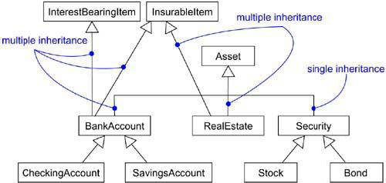
Generalization
A generalization is a relationship between a general thing (called the superclass or parent) and a more specific kind of that thing (called the subclass or child).

Slide 59
Parents, such as InterestBearingItem and InsurableItem, are called mixins because they don't stand alone but, rather, are intended to be mixed in with other parents (such as Asset).
UML defines one stereotype and four constraints that may be applied to generalization relationships.
Implementation: Specifies that the child inherits the implementation of the parent but does not make public nor support its interfaces, thereby violating substitutability.

Slide 60
There are four standard constraints that apply to generalization relationships.
complete: Specifies that all children in the generalization have been specified in the model (although some may be elided in the diagram) and that no additional children are permitted.
incomplete: Specifies that not all children in the generalization have been specified (even if some are elided) and that additional children are permitted.

Slide 61
disjoint: Specifies that objects of the parent may have no more than one of the children as a type.
overlapping: Specifies that objects of the parent may have more than one of the children as a type.
These two constraints apply only in the context of multiple inheritance.

Slide 62
Association
An association is a structural relationship, specifying that objects of one thing are connected to objects of another.
There are four basic adornments that apply to an association: a name, the role at each end of the association, the multiplicity at each end of the association, and aggregation.
other properties you can use to model subtle details, such as navigation, qualification, and various flavors of aggregation.

Slide 63
1. Navigation
Given a plain, unadorned association between two classes, such as Book and Library, it's possible to navigate from objects of one kind to objects of the other kind.
Unless otherwise specified, navigation across an association is bidirectional. There are some circumstances in which we limit navigation to just one direction.

Slide 64
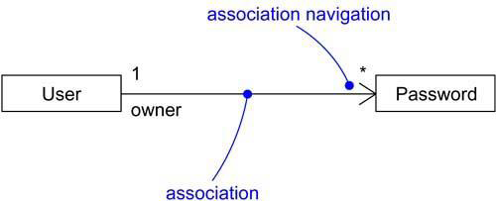
Navigation

Slide 65
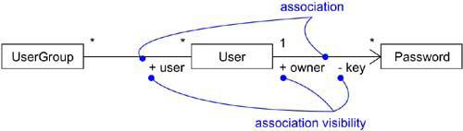
2.Visibility
Given an association between two classes, objects of one class can see and navigate to objects of the other, unless otherwise restricted by an explicit statement of navigation.

Slide 66
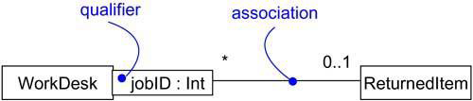
3. Qualification
Given an object at one end of an association, to identify an object or set of objects at the other end.

Slide 67
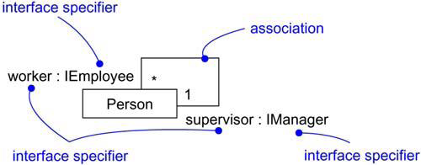
4. Interface Specifier
An interface is a collection of operations that are used to specify a service of a class or a component; every class may realize many interfaces.
Collectively, the interfaces realized by a class represent a complete specification of the behavior of that class.

Slide 68
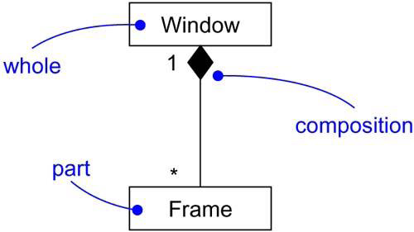
5. Composition

Slide 69
6. Association Classes
In an association between two classes, the association itself might have properties.
For example, in an employer/employee relationship between a Company and a Person, there is a Job that represents the properties of that relationship that apply to exactly one pairing of the Person and Company.

Slide 70
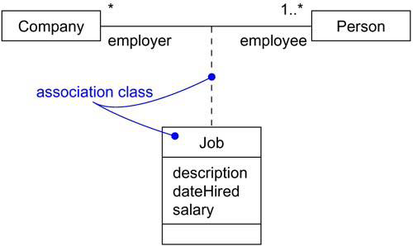
Association Classes

Slide 71
In the UML, you'd model this as an association class, which is a modeling element that has both association and class properties.
An association class can be seen as an association that also has class properties, or as a class that also has association properties.

Slide 72
7. Constraints
UML defines five constraints that may be applied to association relationships.
First, you can distinguish if the association is real or conceptual.
implicit: Specifies that the relationship is not manifest but, rather, is only conceptual.
Second, you can specify that the objects at one end of an association (with a multiplicity greater than one) are ordered or unordered.
2. ordered: Specifies that the set of objects at one end of an association are in an explicit order

Slide 73
Finally, there are three defined constraints that relate to the changeability of the instances of an association.
3.changeable: Links between objects may be added, removed, and changed freely.
4. addOnly: New links may be added from an object on the opposite end of the association.
5. frozen: A link, once added from an object on the opposite end of the association, may not be modified or deleted.

Slide 74
Finally, there is one constraint for managing related sets of associations:
6. xor: Specifies that, over a set of associations, exactly one is manifest for each associated object.

Slide 75
Realization
A realization is a semantic relationship between classifiers in which one classifier specifies a contract that another classifier guarantees to carry out.
Graphically, a realization is rendered as a dashed directed line with a large open arrowhead pointing to the classifier that specifies the contract.

Slide 76
Realization is sufficiently different from dependency, generalization, and association relationships that it is treated as a separate kind of relationship.
You'll use realization in two circumstances: in the context of interfaces and in the context of collaborations.

Slide 77
Realization is used to specify the relationship between an interface and the class or component that provides an operation or service.
An interface is a collection of operations that are used to specify a service of a class or a component.
Therefore, an interface specifies a contract that a class or component must carry out.
An interface may be realized by many such classes or components, and a class or component may realize many interfaces.

Slide 78
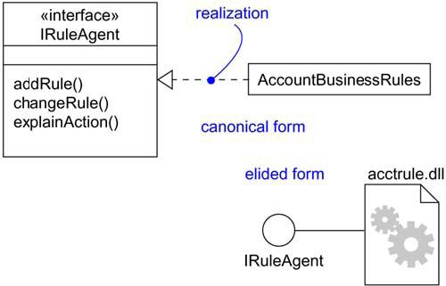
Note that you can represent realization in two ways: in the canonical form (using the interface stereotype and the dashed directed line with a large open arrowhead) and in an elided form (using the interface lollipop notation).
Realization of an Interface

Slide 79
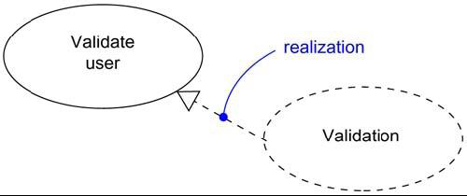
You'll also use realization to specify the relationship between a use case and the collaboration that realizes that use case,
In this circumstance, you'll almost always use the canonical form of realization.
Realization of a Use Case

Slide 80
Ch-11. Interfaces, Types, and Roles
An interface is a collection of operations that are used to specify a service of a class or a component.
A type is a stereotype of a class used to specify a domain of objects, together with the operations (but not the methods) applicable to the object.
A role is the behavior of an entity participating in a particular context.

Slide 81
Graphically, an interface is rendered as a circle; in its expanded form, an interface may be rendered as a stereotyped class in order to expose its operations and other properties.
Interfaces may also be used to specify a contract for a use case or subsystem.

Slide 82
Names
An interface name must be unique within its enclosing package.
Every interface must have a name that distinguishes it from other interfaces.
A name is a textual string. That name alone is known as a simple name; a path name is the interface name prefixed by the name of the package in which that interface lives.

Slide 83
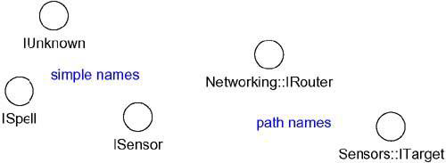
Simple and Path Names

Slide 84
To distinguish an interface from a class, consider prepending an I to every interface name, such as IUnknown and ISpelling.
To distinguish a type from an interface or a class, consider prepending a T to every type, such as TNatural and TCharacter.

Slide 85
Operations
An interface is a named collection of operations used to specify a service of a class or of a component.
Unlike classes or types, interfaces do not specify any structure (so they may not include any attributes), nor do they specify any implementation (so they may not include any methods, which provide the implementation of an operation).

Slide 86
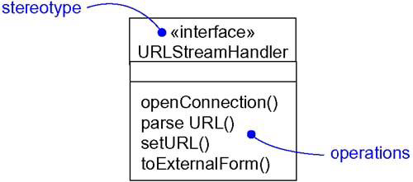
Like a class, an interface may have any number of operations.
Operations

Slide 87
Relationships
Like a class, an interface may participate in generalization, association, and dependency, realization relationships.
Realization is a semantic relationship between two classifiers in which one classifier specifies a contract that another classifier guarantees to carry out.
An interface specifies a contract for a class or a component without dictating its implementation.
A class or component may realize many interfaces.

Slide 88
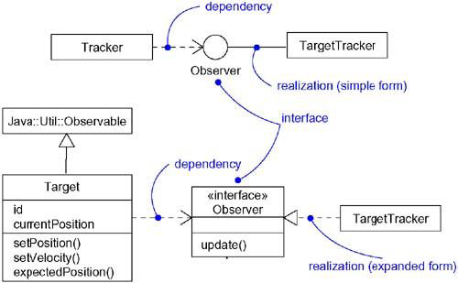
Realizations

Slide 89
First, you can use the simple form in which the interface and its realization relationship are rendered as a lollipop sticking off to one side of a class or component.
Second, you can use the expanded form in which you render an interface as a stereotyped class, which allows you to visualize its operations and other properties, and then draw a realization relationship from the classifier or component to the interface.

Slide 90
Roles
A class may realize many interfaces. An instance of that class must therefore support all those interfaces, because an interface defines a contract, and any abstraction that conforms to that interface must, by definition, faithfully carry out that contract.
In a given context, an instance may present only one or more of its interfaces.
In that case, each interface represents a role that the object plays.

Slide 91
A role names a behavior of an entity participating in a particular context.
Stated another way, a role is the face that an abstraction presents to the world.
For example, consider an instance of the class Person. Depending on the context, that Person instance may play the role of Mother, Employee, Customer, Manager, Pilot, Singer, and so on.

Slide 92
When an object plays a particular role, it presents a face to the world, and clients that interact with it expect a certain behavior depending on the role that it plays at the time.
For example, an instance of Person in the role of Manager would present a different set of properties than if the instance were playing the role of Mother.

Slide 93
Types
If you want to formally model the semantics of an abstraction and its conformance to a specific interface, you'll want to use the defined stereotype type.
Type is a stereotype of class, and you use it to specify a domain of objects, together with the operations (but not the methods) applicable to the objects of that type.
The concept of type is closely related to that of interface, except that a type's definition may include attributes while an interface may not.

Slide 94
Ch-12. Packages
Visualizing, specifying, constructing, and documenting large systems involves manipulating potentially large numbers of classes, interfaces, components, nodes, diagrams, and other elements.
In the UML, the package is a general purpose mechanism for organizing modeling elements into groups.

Slide 95
A package is a general-purpose mechanism for organizing elements into groups. Graphically, a package is rendered as a tabbed folder.
Names:-
A package name must be unique within its enclosing package.
Every package must have a name that distinguishes it from other packages.

Slide 96
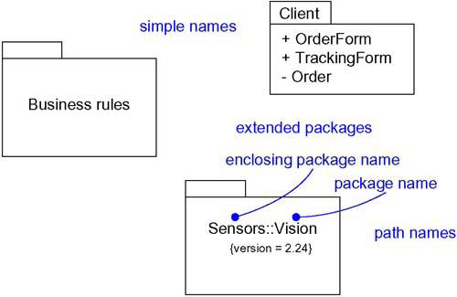

Slide 97
Owned Elements:-
A package may own other elements, including classes, interfaces, components, nodes, collaborations, use cases, diagrams, and even other packages.
Owning is a composite relationship, which means that the element is declared in the package. If the package is destroyed, the element is destroyed.

Slide 98
A package forms a namespace, which means that elements of the same kind must be named uniquely within the context of its enclosing package.
For example, you can't have two classes named Queue owned by the same package, but you can have a class named Queue in package P1 and another (and different) class named Queue in package P2. The classes P1::Queue and P2::Queue are, in fact, different classes and can be distinguished by their path names.

Slide 99
Elements of different kinds may have the same name within a package.
Thus, you can have a class named Timer, as well as a component named Timer, within the same package.

Slide 100
Packages may own other packages. This means that it's possible to decompose your models hierarchically.
For example, you might have a class named Camera that lives in the package Vision that in turn lives in the package Sensors. The full name of this class is Sensors :: Vision :: Camera.

Slide 101
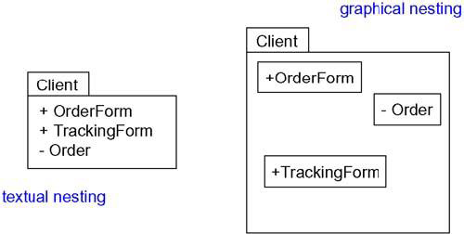
Visibility:-
The visibility of the elements owned by a package is just as you can control the visibility of the attributes and operations owned by a class.

Slide 102
In the Figure, OrderForm is a public part of the package Client, and Order is a private part.
A package that imports Client can see OrderForm, but it cannot see Order.
As viewed from the outside, the fully qualified name of OrderForm would be Client::OrderForm.

Slide 103
Protected elements are visible only to packages that inherit from another package;
Private elements are not visible outside the package at all.

Slide 104
Importing and Exporting:-
Suppose you have two classes named A and B sitting side by side. Because they are peers, A can see B and B can see A, so both can depend on the other. Just two classes makes for a trivial system, so you really don't need any kind of packaging.

Slide 105
Now, imagine having a few hundred such classes sitting side by side.
Furthermore, there's no way that you can understand such a large, unorganized group of classes. That's a very real problem for large systems--simple, unrestrained access does not scale up. For these situations, you need some kind of controlled packaging to organize your abstractions.

Slide 106
Importing grants a one-way permission for the elements in one package to access the elements in another package.
In the UML, you model an import relationship as a dependency adorned with the stereotype import.

Slide 107
The public parts of a package are called its exports.
For example, in Figure, the package GUI exports two classes, Window and Form. EventHandler is not exported by GUI; EventHandler is a protected part of the package.

Slide 108
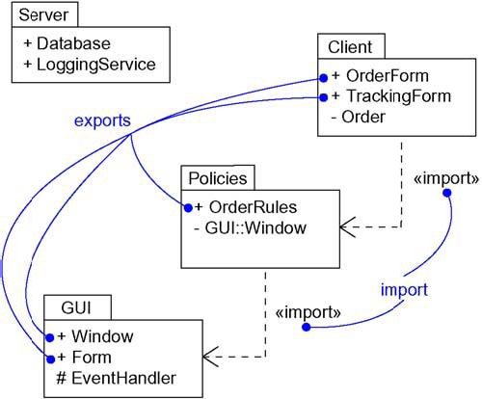

Slide 109
Generalization
There are two kinds of relationships you can have between packages: import and access dependencies, used to import into one package elements exported from another, and generalizations, used to specify families of packages.

Slide 110
Generalization among packages is very much like generalization among classes.
For example, in Figure, the package GUI is shown to export two classes (Window and Form) and one protected class (EventHandler).
Two packages specialize the more general package GUI: WindowsGUI and MacGUI. These specialized packages inherit the public and protected elements of the more general package.

Slide 111
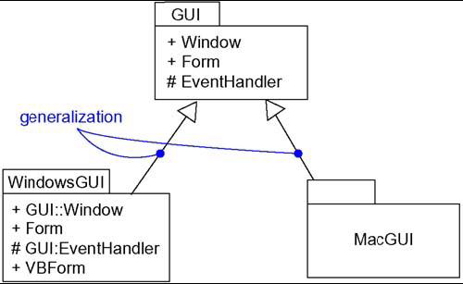

Slide 112
Standard Elements
All of the UML's extensibility mechanisms apply to packages.
The UML defines five standard stereotypes that apply to packages.
facade: Specifies a package that is only a view on some other package.
framework: Specifies a package consisting mainly of patterns

Slide 113
stub: Specifies a package that serves as a proxy for the public contents of another package.
subsystem: Specifies a package representing an independent part of the entire system being modeled.
system: Specifies a package representing the entire system being modeled.

Slide 114
Common Modeling Techniques
Modeling Groups of Elements
Scan the modeling elements in a particular architectural view and look for clumps defined by elements that are conceptually or semantically close to one another.
Surround each of these clumps in a package.

Slide 115
For each package, distinguish which elements should be accessible outside the package. Mark them public, and all others protected or private. When in doubt, hide the element.
Explicitly connect packages that build on others via import dependencies.
In the case of families of packages, connect specialized packages to their more general part via generalizations.

Slide 116
Modeling Groups of Elements

Slide 117
Modeling Architectural Views:-
Identify the set of architectural views that are significant in the context of your problem. In practice, this typically includes a design view, a process view, an implementation view, a deployment view, and a use case view.
Place the elements (and diagrams) that are necessary and sufficient to visualize, specify, construct, and document the semantics of each view into the appropriate package.

Slide 118
As necessary, further group these elements into their own packages.
There will typically be dependencies across the elements in different views. So, in general, let each view at the top of a system be open to all others at that level.

Slide 119
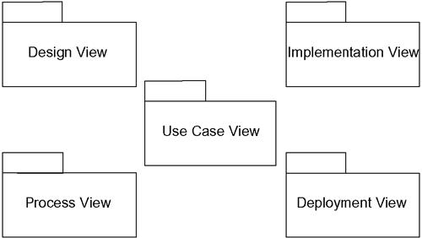
Modeling Architectural Views

Slide 120
Object Diagrams
Object diagrams model the instances of things contained in class diagrams. An object diagram shows a set of objects and their relationships.
We use object diagrams to model the static design view or static process view of a system.
Object diagrams are not only important for visualizing, specifying, and documenting structural models, but also for constructing the static aspects of systems through forward and reverse engineering.

Slide 121
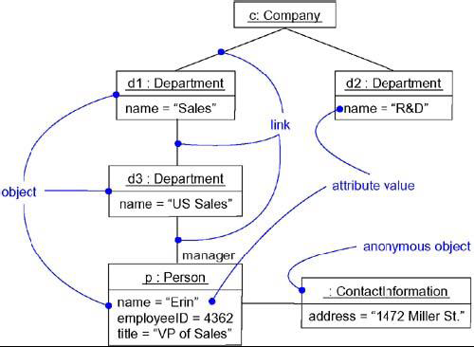
Object Diagram

Slide 122
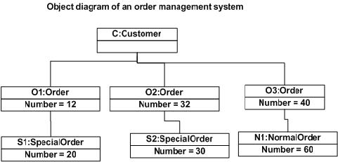

Slide 123
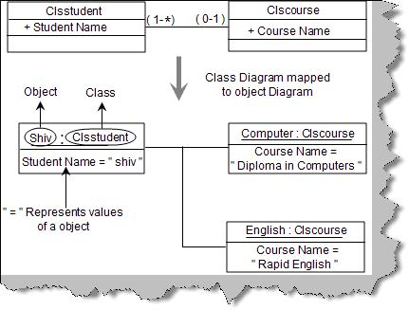

Slide 124
An object diagram is a diagram that shows a set of objects and their relationships at a point in time.
Graphically, an object diagram is a collection of vertices and arcs.
An object diagram is a special kind of diagram and shares the same common properties as all other diagrams that is, a name and graphical contents that are a projection into a model.

Slide 125
Object diagrams commonly contain
Objects
Links
Like all other diagrams, object diagrams may contain notes and constraints.
Object diagrams may also contain packages or subsystems, both of which are used to group elements of your model into larger chunks.

Slide 126
Object diagrams to model the static design view or static process view of a system just as you do with class diagrams.

Slide 127
When you model the static design view or static process view of a system, you typically use object diagrams in one way:
To model object structures:-
Modeling object structures involves taking a snapshot of the objects in a system at a given moment in time.
object diagrams are used to visualize, specify, construct, and document the existence of certain instances in your system, together with their relationships to one another.

Slide 128
Common Modeling Techniques
Modeling Object Structures
Identify the mechanism you'd like to model. A mechanism represents some function or behavior of the part of the system you are modeling that results from the interaction of a society of classes, interfaces, and other things.
For each mechanism, identify the classes, interfaces, and other elements that participate in this collaboration; identify the relationships among these things, as well.

Slide 129
Consider one scenario that walks through this mechanism. Freeze that scenario at a moment in time, and render each object that participates in the mechanism.
Expose the state and attribute values of each such object, as necessary, to understand the scenario.
Similarly, expose the links among these objects, representing instances of associations among them

Slide 130
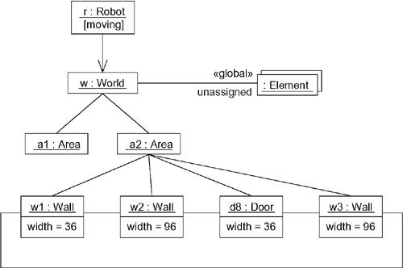

Slide 131
Forward and Reverse Engineering
Forward engineering (the creation of code from a model) an object diagram is theoretically possible but pragmatically of limited value. In an object-oriented system, instances are things that are created and destroyed by the application during run time. Therefore, you can't exactly instantiate these objects from the outside.

Slide 132
Reverse engineering (the creation of a model from code) an object diagram is a very different thing.

